Slide 1
Engineering Chemistry F. Y. B. Tech.
Dr. Jitendra Satam

Slide 2
Numerical on EDTA method
a) 0.28 g of CaCO₃ was dissolved in HCl and the solution is diluted to 1 litre. 100 mL of the above solution required 28 mL of EDTA solution.
100 mL of unknown hard water sample required 33 mL of EDTA solution.
After boiling, cooling and filtration 100 mL of this solution on titration required 10 mL of EDTA solution. Calculate all types of hardness.

Slide 3
Concentration of SHW = 0.28 g CaCO₃ / litre
= 0.28 mg CaCO₃ / ml
1 ml of SHW = 0.28 mg of CaCO₃
And 100 ml of SHW = 28 mg of CaCO₃
But, 100 ml of SHW = 28 ml of EDTA
1 ml of EDTA = (100 /28) ml of SHW
= (100 /28) x 0.28 mg of CaCO₃
1 ml of EDTA = 1 mg of CaCO₃

Slide 4
Total Hardness:
100 ml of unknown water sample = 33 ml of EDTA
= 33 x 1 mg of CaCO₃
Total hardness = 33 x 1 mg x 1000/100 mg /L
= 330 ppm or mg /l
Permanent Hardness:
100 ml of unknown water sample = 10 ml of EDTA
= 10 x 1 mg of CaCO₃
Permanent hardness = 10 x 1 mg x 1000/100 mg /L
= 100 ppm or mg /l
Temporary Hardness: (330 – 100) = 230 ppm

Slide 5
Numerical on EDTA method
b) 55.5 mg of CaCl₂ is dissolved in 750 ml of distilled water and 50 ml of this water on titration required 14 ml of EDTA.
100 ml of water sample on titration with same EDTA required 9.8 ml.
50 ml of boiled water sample on titration required 2.7 ml of same EDTA. Calculate the all types of hardness.

Slide 6
750 ml of SHW = 55.5 mg of CaCl₂
= (55.5 / 750) x 100/111 mg of CaCO₃
1 ml of SHW = 0.067 mg of CaCO₃
50 ml of SHW = 14 ml of EDTA
1 ml of EDTA = 50 /14 ml of SHW
= 50 /14 x 0.067 mg of CaCO₃
1 ml of EDTA = 0.24 mg of CaCO₃

Slide 7
Total Hardness
100 ml of water sample = 9.8 ml of EDTA = 9.8 x 0.24 mg of CaCO₃
Total hardness = 9.8 x 0.24 x 1000/100 mg /L = 23.52 ppm or mg /l
Permanent Hardness:
50 ml of unknown water sample = 2.7 ml of EDTA
= 2.7 x 0.24 mg of CaCO₃
Permanent hardness = 2.7 x 0.24 mg x 1000/50 mg /L
= 12.96 ppm or mg /l
Temporary Hardness: (23.52 – 12.96) = 10.56 ppm

Slide 8
c) 50 mL sample of water required 8.2 mL of M/20 Disodium EDTA solution for titration. After boiling and filtration the same volume required 4.5 mL of EDTA. Calculate all types of hardness.
Total Hardness:
M/20 EDTA = 0.05 M EDTA
1000 mL, 1 M EDTA = 100 g CaCO₃
1 mL, 1 M EDTA = 100 mg CaCO₃
50 mL water sample = 8.2 mL of 0.05 M EDTA
1000 mL water sample = 20 x 8.2 M of 0.05 M EDTA
= 164 mL of 0.05 M EDTA
1 mL, 1 M EDTA = 100 mg CaCO₃
164 mL of 0.05 M EDTA = 164 x 0.05 x 100 = 820 ppm = Total Hardness

Slide 9
Permanent hardness:
Now, 50 mL of boiled water = 4.5 mL of 0.05 M EDTA
1000 mL water sample = 20 x 4.5 M of 0.05 M EDTA
= 90 mL of 0.05 M EDTA
As, 1 mL, 1 M EDTA = 100 mg CaCO₃
90 mL of 0.05 M EDTA = 90 x 0.05 x 100
= 450 ppm = Permanent hardness
Temporary hardness = 820 – 450 = 370 ppm

Slide 10
d) 25 mL sample of water required 5.5 mL of M/10 Disodium EDTA solution for titration. After boiling and filtration 50 mL of water sample required 3.9 mL of EDTA. Calculate all types of hardness.

Slide 11
Softening Methods
Lime-Soda Method
Zeolite Softener method
Ion Exchange Method

Slide 12
Lime-Soda Method
In this method, calculated quantity of Lime [Ca(OH)₂] and Soda [Na₂CO₃] mixture is added to hard water.
Precipitates of CaCO₃ and Mg(OH)₂ are formed due to reactions of hardness causing salts with lime and soda.
These precipitates gets settled down in the form of sludge.
This settling of precipitates is faster in hot lime soda method compared to cold Lime soda method.
Hence for quick settling of particles of CaCO₃ and Mg(OH)_{2,} coagulants such as Alum [Al₂(SO₄)₃], sodium meta aluminate [NaAlO₂], or FeSO₄ could be used in cold lime soda method.

Slide 13
Name of Impurities | Reaction with Lime | Reaction With Soda | L & S Requirement
Temp Ca | Ca(OH)₂ + Ca(HCO₃)₂ --------> 2CaCO₃ + 2H₂O | No Reaction | L
Temp Mg | Mg(HCO₃)₂ + 2Ca(OH)₂ --------> Mg(OH)₂ + 2CaCO₃ + 2H₂O | No Reaction | 2L
Perm Ca | No Reaction | CaSO₄ + Na₂CO₃ --------> CaCO₃ + Na₂SO₄ | S
Perm Mg | Ca(OH)₂ + MgSO₄ --------> CaSO₄ + Mg(OH)₂ | CaSO₄ + Na₂CO₃--------> CaCO₃ + Na₂SO₄ | L+ S
Perm Al | 3Ca(OH)₂ + Al₂(SO₄)₃ -------> 2Al(OH)₃ + 3CaSO₄ | CaSO₄ + Na₂CO₃ --------> CaCO₃ + Na₂SO₄ | L + S

Slide 14
Name of Impurities | Reaction with Lime | Reaction With Soda | L & S Requirement
Perm Fe | Ca(OH)₂ +FeSO₄ --------> Fe(OH)₂ + CaSO₄ | CaSO₄ +Na₂CO₃ --------> CaCO₃ + Na₂SO₄ | L + S
CO₂ | CO₂ + Ca(OH)₂ --------> 2CaCO₃ + 2H₂O | No Reaction | L
H⁺ (HCl or H₂SO₄ | 2HCl + Ca(OH)₂ --------> CaCl₂ + H₂O | CaCl₂ + Na₂CO₃ --------> CaCO₃ + 2NaCl | L + S
NaHCO₃ | 2NaHCO₃ + Ca(OH)₂ --------> CaCO₃ + Na₂CO₃ +2H₂O | No Reaction | L - S
NaAlO₂ | NaAlO₂ + H₂O --------> Al(OH)₃ + NaOH |  | (-L) eq. to Ca(OH)₂

Slide 15
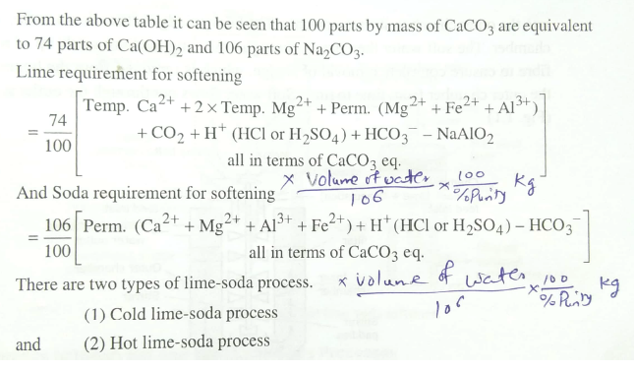

Slide 16
Cold Lime-Soda Method
In cold lime-soda method, hard water is treated with mixture of lime, soda and coagulants at room temperature about 25-30 ⁰C
Inner cylindrical reaction tank equipped with stirrer, which ensures complete mixing of lime, soda and coagulants with hard water
In outer conical sedimentation vessel, sludge settles down
Wood fiber filters ensures the complete removal of sludge particles from softened water

Slide 17
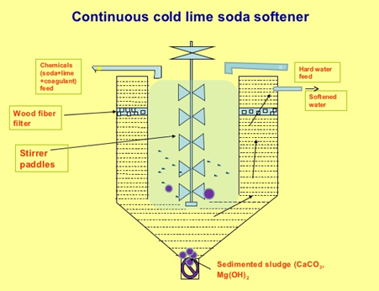
Cold Lime-Soda Method
Carried out at 25 ⁰C to 30 ⁰C
Coagulants required
Stirring is essential as the reaction is operated at low temperature
Slow process
Dissolved gases are not removed
Filtration is not easy
Residual hardness is 50-60 ppm
Low softening capacity

Slide 18
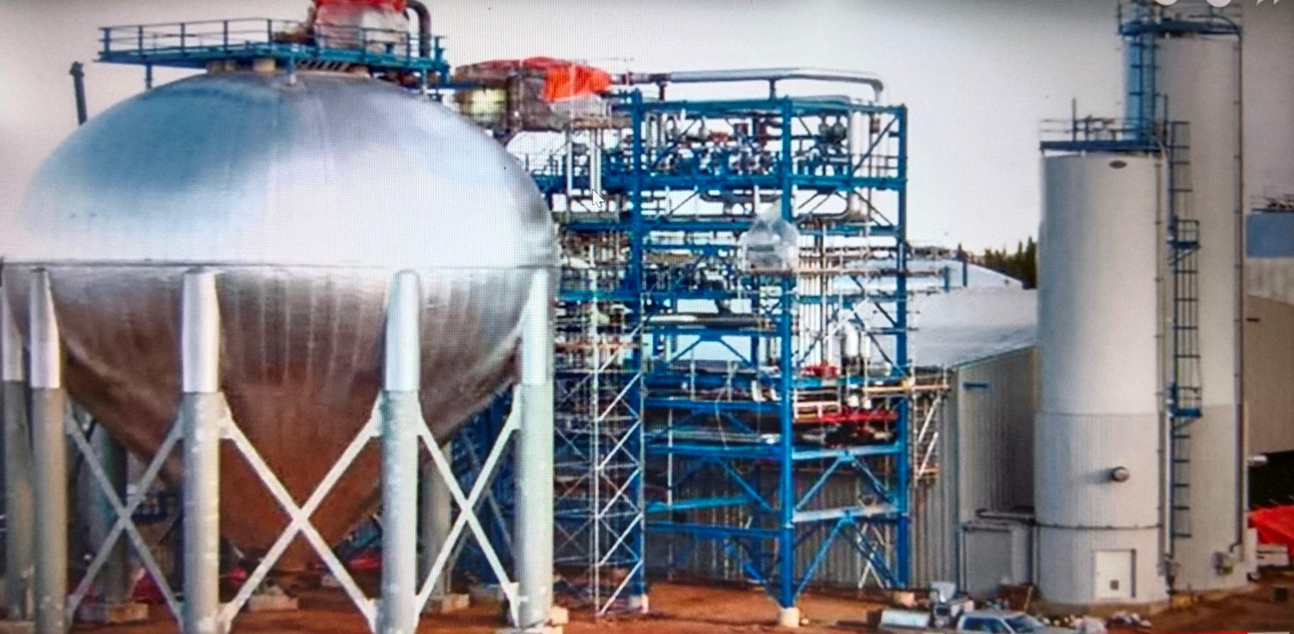
Industrial Lime-Soda process

Slide 19
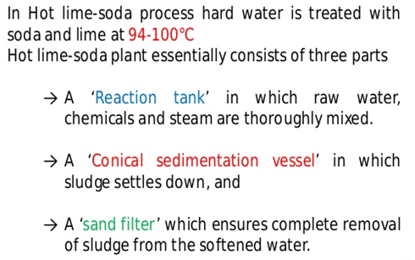
Hot Lime-Soda Method

Slide 20
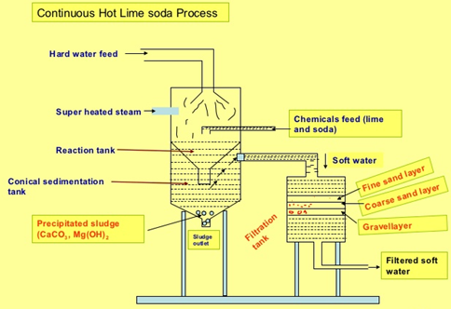
Hot Lime-Soda Method
Carried out at 95 ⁰C to 100 ⁰C
Coagulants are not required
Stirring is not essential as the reaction is operated at high temperature
Fast process
Dissolved gases gets removed due to high temperature
Filtration is easy, hence sand filter is sufficient
Residual hardness is 15-30 ppm
High softening capacity

Slide 21
Advantages of hot lime-soda method over cold lime-soda method
Economical process
pH value of softened water is high (Decrease corrosion)
Alkaline nature of treated water reduces pathogens, bacteria in water
Fe (II) and Mn (II) can also be removed to certain extent

Slide 22
Disadvantages of Lime-soda method
Softened water is 50 ppm hardness in cold lime-soda method and 15-30 ppm hardness in hot lime-soda method.
Such water can not be used in high pressure boilers
Disposal of large quantity of sludge is a big problem

Slide 23
Zeolite Softener Method
Sodium-Zeolites which are hydrated sodium alumino silicates, capable of exchanging their sodium ions with hardness producing ions are used.
Chemically sodium zeolites are Na₂O.Al₂O₃.xSiO₂.yH₂O
(Where, x= 2-10 & y= 2-6).
Principle: hard water passed over zeolite, it exchanges its own sodium ions with hardness causing ions.
2Na⁺ ions are generally exchanged with each bivalent hardness producing ions.

Slide 24
Process
For softening, hard water is passed over zeolite bed at specific rate
The hardness causing ions will be retained on zeolite and they are exchanged with equivalent sodium ions
After certain usage zeolite gets exhausted as all the sodium ions got exchanged
Such exhausted zeolite is regenerated by passing 10 % brine solution over it
This regenerates the zeolite by replacing hardness causing ions with Na⁺ ions to become Na-zeolite
Hence softening and regeneration are exactly opposite reactions

Slide 25
Reactions
Softening:
For softening of hard water, it is passed over sodium zeolite bed. Exchange of hardness causing ions takes place with sodium ions present on zeolite. The following reactions takes place.
CaCl₂ + Na₂Ze CaZe + 2NaCl
MgSO₄ + Na₂Ze MgZe + Na₂SO₄
Regeneration:
For regeneration of exhausted zeolite, 10 % brine solution is passed over used zeolite.
CaZe + 2NaCl CaCl₂ + Na₂Ze
MgZe + 2NaCl MgCl₂ + Na₂Ze

Slide 26
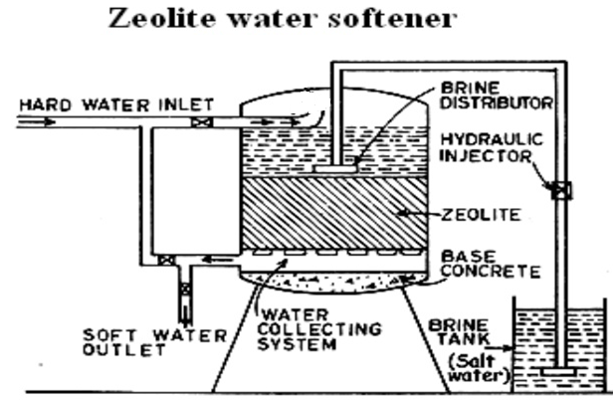

Slide 27
Advantages
Water obtained after treatment is about 10 ppm hardness
No sludge formation is taking place
Equipment is compact and easy in operation
Equipment occupies less space and low in maintenance

Slide 28
Limitations and Disadvantages of Zeolite softener method
Limitations
Suspended impurities blocks the pores of zeolite
Colored ions such as Fe³⁺ and Mn²⁺ forms strong bonds with zeolite hence can not be removed while regeneration from zeolite
Mineral acids can destroy zeolite
Disadvantages
The treated water is high in sodium salts
Only cations could be removed leaving behind anions in water

Slide 29
Ion Exchange softener method (De-mineralization process)
Ion exchange resins are insoluble, cross-linked, long chain organic polymers with micro-porous structure. The functional groups attached to the chains are responsible for ion exchanging property.
Cation Exchanger resins (RH⁺) :
Resins containing acidic functional groups (-COOH, -SO₃H etc.) are capable of exchanging their H⁺ ions with other cations in hard water.
Anion Exchanger resins (ROH⁻) :
Resins containing basic functional groups (-NH₂-OH, =NH-OH, -NMe₂-OH etc.) are capable of exchanging their OH⁻ with other anions in hard water.

Slide 30
Process - Softening
For softening, hard water is first passed over cations exchanger resin column at specific rate, which removes cations like Ca²⁺, Mg²⁺ etc. from hard water.
The hardness causing ions will be retained on cation exchanger resin and they are exchanged with equivalent amount of H⁺ ions
Further, the softened water from cation exchanger column is passed through anion exchanger column, which removes anions like, SO₄²⁻, Cl⁻, CO₃²⁻ etc. with equivalent amount of OH⁻ ions from the resin.
H⁺ and OH⁻ ions from resin columns combines to form water.
Softening
2 RH⁺ + CaCl₂ R₂Ca²⁺ + 2HCl
2 RH⁺ + MgSO₄ R₂Mg²⁺ + H₂SO₄
2 ROH⁻ + 2Cl⁻ R₂Cl⁻ + 2 OH⁻
2 ROH⁻ + SO₄²⁻ R₂SO₄²⁻ + 2 OH⁻

Slide 31
Process - Regeneration
After certain usage both cation and anion exchanger resins gets exhausted and they can not exchange any more cations or anions.
Exhausted cation exchanger resin is regenerated by passing dil. HCl solution
Exhausted anion exchanger resin is regenerated by passing dil. NaOH solution
This regenerates both the resins making the method reusable.
Regeneration
R₂Ca²⁺ + 2HCl 2 RH⁺ + CaCl₂
R₂Mg²⁺ + H₂SO₄ 2 RH⁺ + MgSO₄
R₂Cl⁻ + 2 NaOH 2 ROH⁻ + 2NaCl
R₂SO₄²⁻ + 2 NaOH 2 ROH⁻ + Na₂SO₄

Slide 32
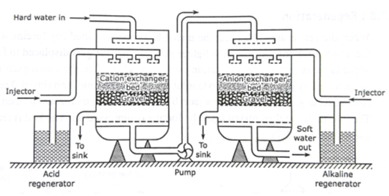
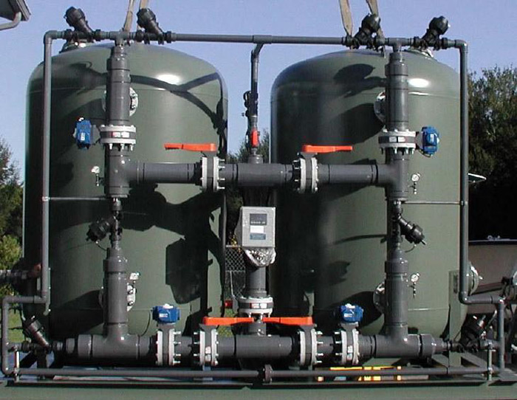
Ion Exchange Softener
(Commercial plant)

Slide 33
Advantages
The process can be used for highly acidic or alkaline water.
It produces water of very low hardness (less than 2 ppm).
Softened water can be used in steam generation boilers.
Disadvantages
The equipment is costly, and expensive resins are required.
Turbid water could decrease the efficiency of the method. Hence, turbidity needs to be removed first by coagulation, then water could be passed over the resin.

